Slide 1


Slide 2
E-COMMERCE SHOPPING STORE TEAM MEMBERS: - SARANG.N - ABHISHEK.S - KEERTHANA.M
Sprint-1
Team 2

Slide 3
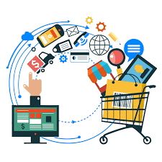
CONTENT
SOFTWARES USED
CLASS DIAGRAM
BLOCK DIAGRAM
E-COMMERCE SHOPPING STORE LAYERS
MVC
VIEWS
CONCLUSION

Slide 4

What is E-Commerce
Commonly known as Electronics Marketing.
“It consist of buying and selling goods and services over an electronic systems using Internet and other computer networks technology.”

Slide 5
SOFTWARE USED
FRONTEND: ASP.NET CORE MVC
BACKEND: SQL SERVER
TESTING: SWAGGER

Slide 6
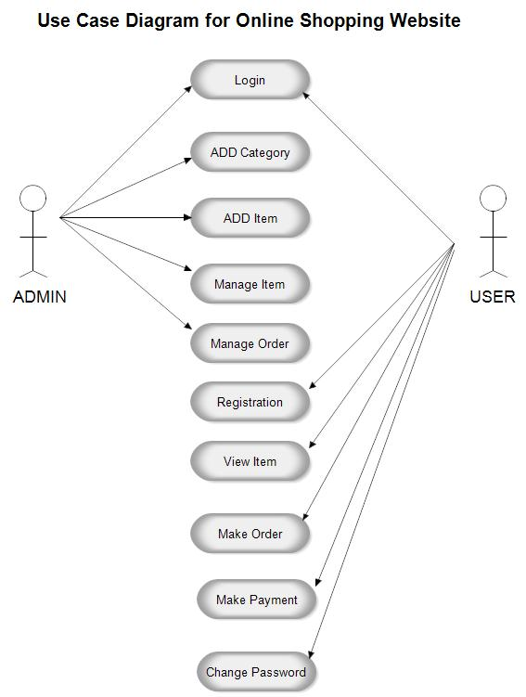
CASE DIAGRAM

Slide 7

E-COMMERCE SHOPPING STORE HAS
BL
DAL
EF CORE
ENTITIES
WEB API
MVC

Slide 8
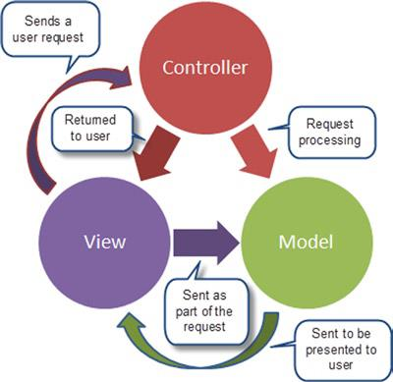
MVC – FLOW CHART

Slide 9

VIEWS
For each controller the respective views folder is generated.
Each view has Create, Edit, Delete, Details and Index Views respectively.
Views consists of html code.

Slide 10
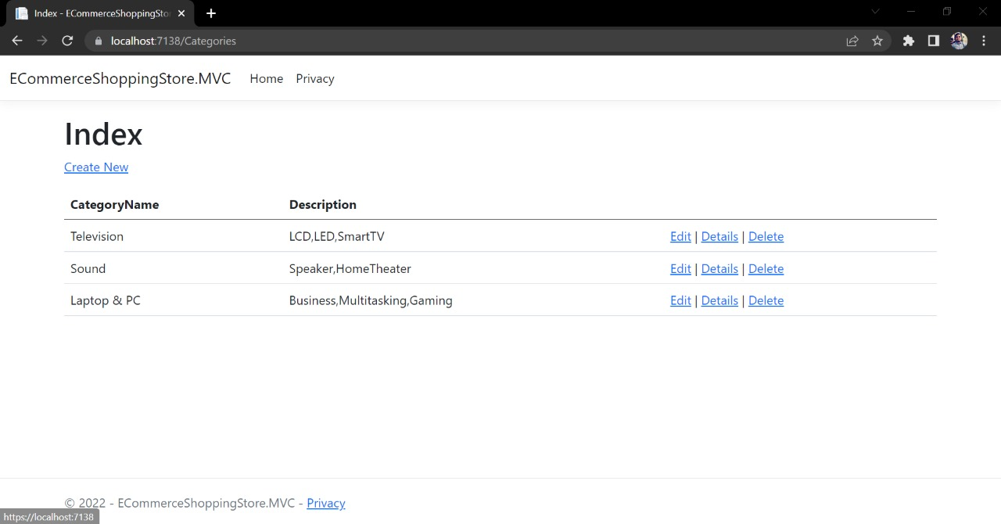
CATEGORIES - VIEWS

Slide 11
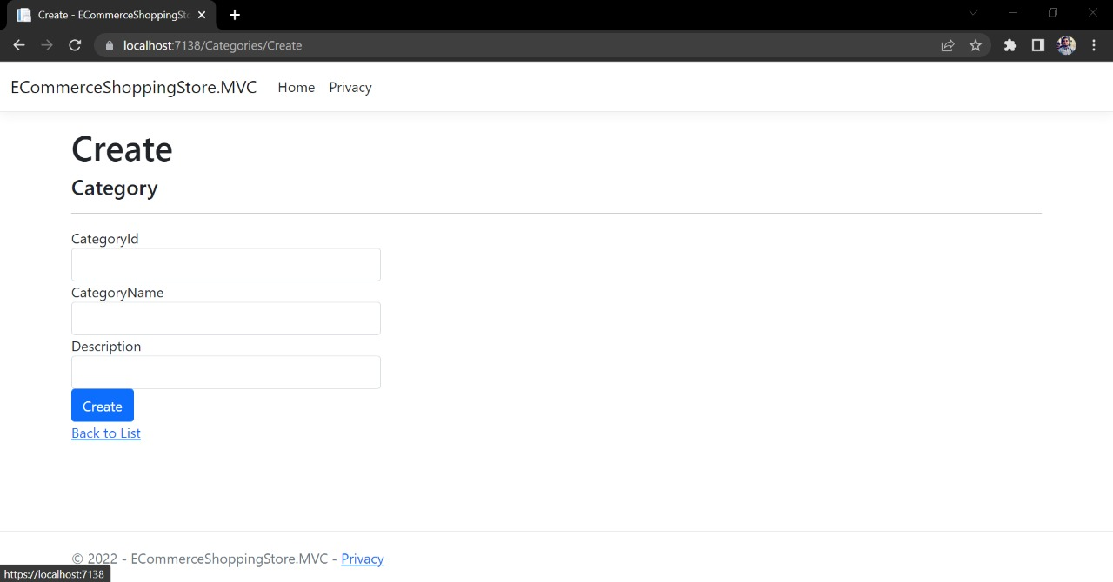

Slide 12
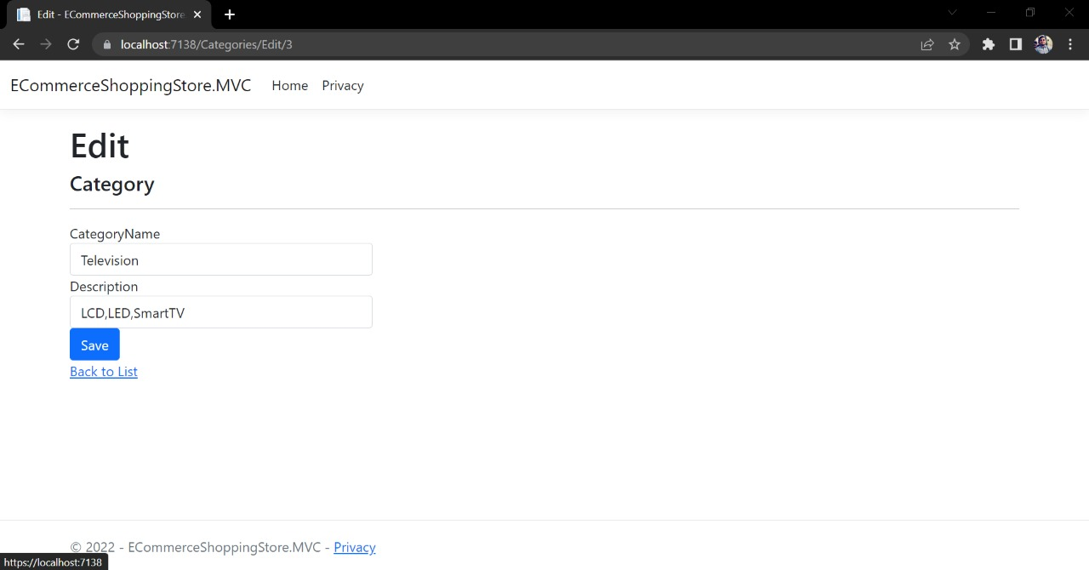

Slide 13
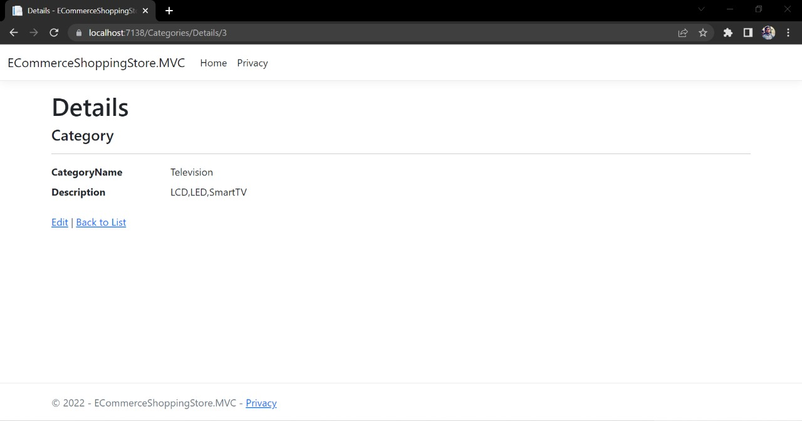

Slide 14
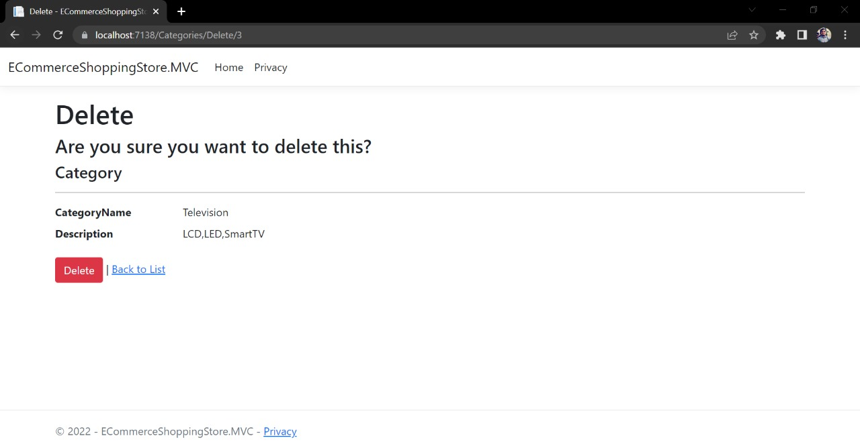

Slide 15
CONCLUSION
Internet has lead to the birth and evolution of E-Commerce.
E-Commerce has now become a key component of many organizations in the daily running of their business.
E-Commerce Shopping store helps the customer to buy their desired products easily.
HAPPY SHOPPING !!

